Slide 1
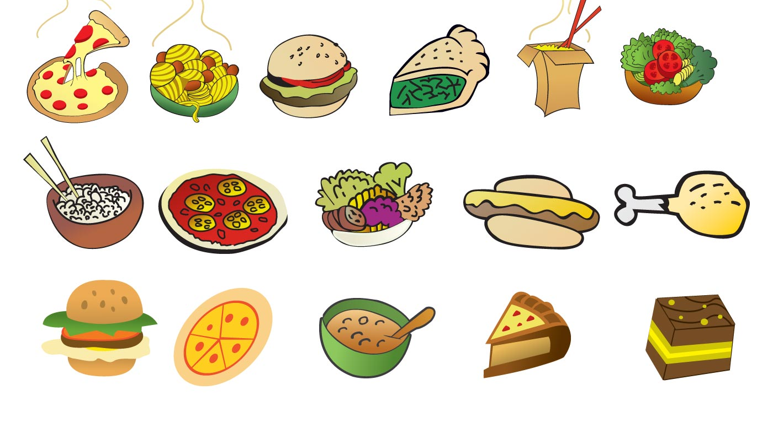
A que sabe?
What does it taste like?
Senorita Fisher
DPA Middle Spanish
This Photo by Unknown Author is licensed under CC BY

Slide 2
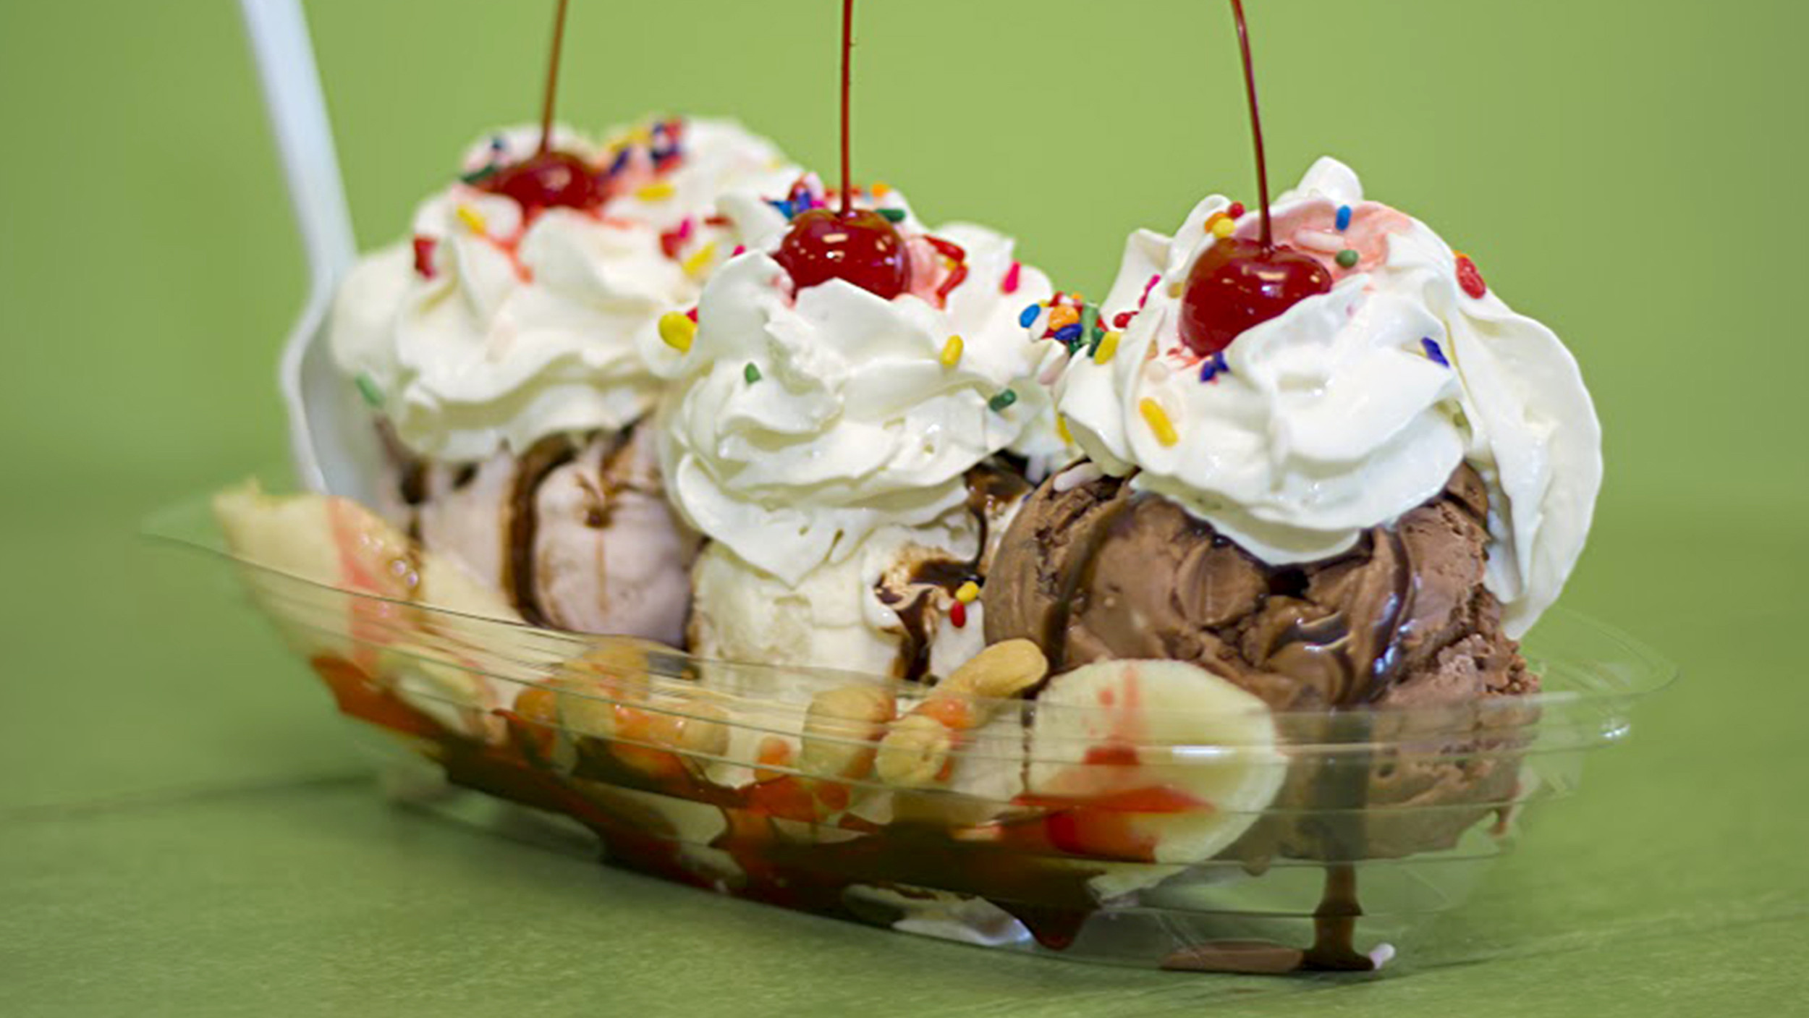
Sabe a…
It tastes like…
This Photo by Unknown Author is licensed under CC BY-SA

Slide 3
Sabe a los Oreos

Slide 4
Sabe a los M&M’s

Slide 5
Sabe a los Kitkats

Slide 6
Sabe a fresa

Slide 7
Sabe a chocolate

Slide 8
Sabe a naranjas

Slide 9
Sabe a manzanas

Slide 10
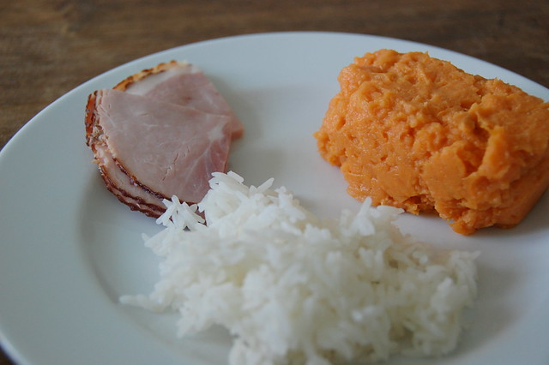
When you want to describe the food using an adjective, you say “Sabe ____(adjective)____. In this case we ask, Como sabe? (How does it taste?
EX:
It tastes bland
“Sabe soso”
This Photo by Unknown Author is licensed under CC BY-NC

Slide 11
Como sabe?
This Photo by Unknown Author is licensed under CC BY-SA

Slide 12
Como sabe?
This Photo by Unknown Author is licensed under CC BY-SA

Slide 13
Como sabe?
This Photo by Unknown Author is licensed under CC BY-SA

Slide 14
Como sabe?
This Photo by Unknown Author is licensed under CC BY

Slide 15
You can also use “es” to describe food.
EX:
Como sabe?
Es soso
It is custom to use muy (very) or un poco (a little)
EX: Es muy soso OR Es un poco soso
This Photo by Unknown Author is licensed under CC BY-NC

Slide 16
Como sabe?
This Photo by Unknown Author is licensed under CC BY-SA

Slide 17
Como sabe?
This Photo by Unknown Author is licensed under CC BY-SA

Slide 18
Como sabe?
This Photo by Unknown Author is licensed under CC BY-SA

Slide 19
Como sabe?
This Photo by Unknown Author is licensed under CC BY

